Slide 1


EFFECT OF SOCIOECONOMIC, DEMOGRAPHIC FACTORS, MENTAL HEALTH AND POLITICS ON CRIME
Presented by: Rishabh Kandoi, Richa Yadav
Notes:
Good Afternoon, everyone!
I am Richa and this is Rishabh and
today we are going to talk about the relationships that we discovered between social media sentiments, Socioeconomic/demographic factors, mental health, and politics on criminal activities all over the USA.

Slide 2



TABLE OF CONTENT
01
02
03
04
05
06
PROBLEM STATEMENT
DATA COLLECTION & EDA
MODELING TECHNIQUES
INFERENCES
FUTURE SCOPE
QUESTIONS
Notes:
We are going to discuss the problem statement, Data collection & EDA, Modelling Techniques, Inferences/Insights and our future scope.

Slide 3

PROBLEM STATEMENT
Extensive prior research[1] in crime analysis suggests how crime is correlated with the male-female ratio, unemployment, and income scale.
Our problem statement is to find enough evidence that people's sentiments on social media, public safety personnel, political inclinations, and mental health add value to the above approach.
Notes:
We took inspiration from a reference paper published in 2018 on how factors like the male-female ratio, unemployment, and income scale correlate with criminal behavior.
We wanted to collect enough evidence that variables like Social Media Sentiments, Public Safety Workforce, presidential party affiliations, and mental health can also be used to further strengthen the correlation with criminal behaviour.

Slide 4
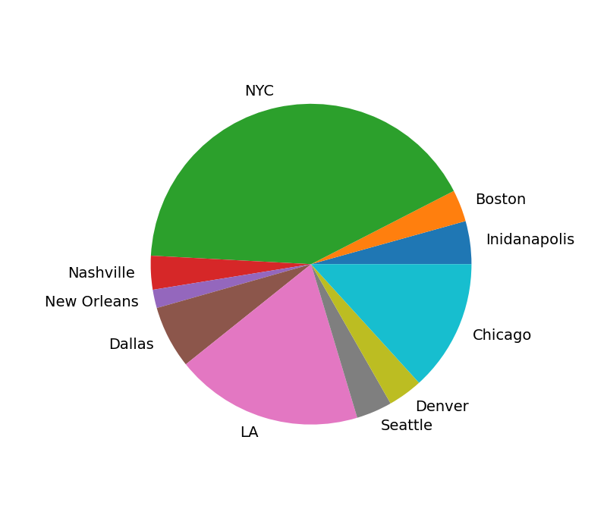
DATA COLLECTION
Selection of cities
Cites from all over the country with low and high population groups were selected to ensure unbiased data analysis.
Based on the factors above, the following cities are considered:
Boston
New York City
Indianapolis
Nashville
New Orleans
Dallas
Los Angeles
Denver
Seattle
Chicago
The chart above represents the population distribution(basis 2021 Census)
Notes:
We collected data from 10 cities as listed above on the basis of the population distribution to account for both small cities like New Orleans or Denver and large cities like NYC, Chicago

Slide 5
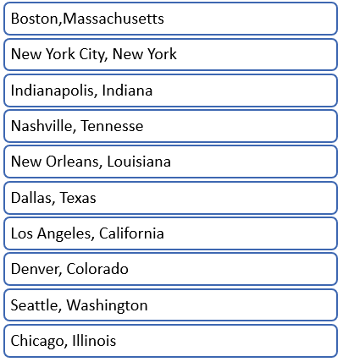
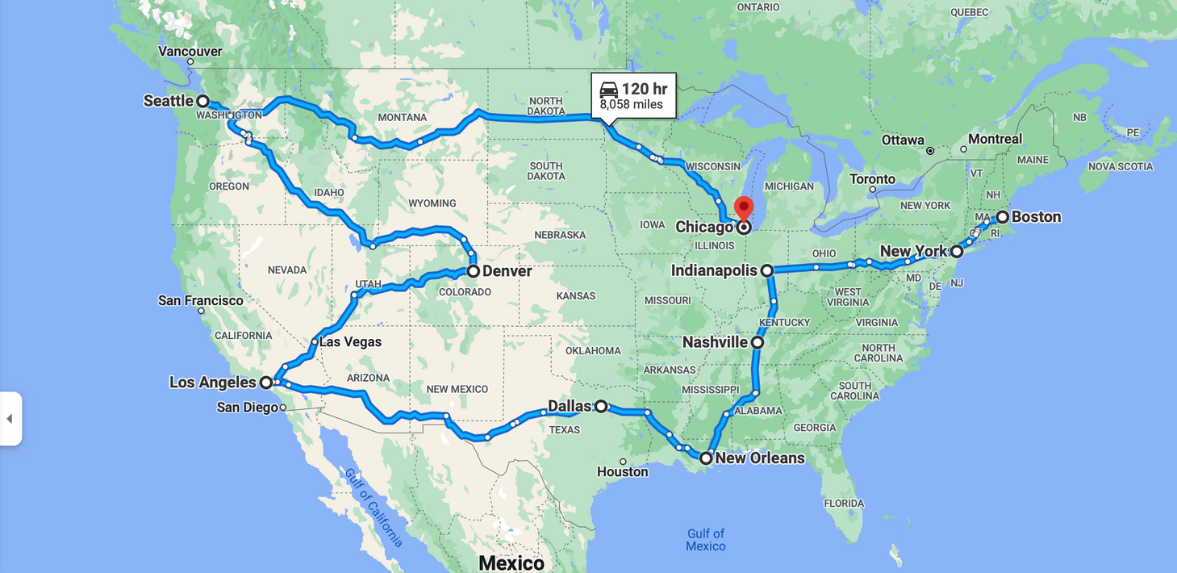
DATA COLLECTION
Selection of cities
The map above represents the geographical span of the cities selected.
Notes:
While keeping the population distribution in mind, we also considered the geographical span of the selected 10 cities. As you can see, we covered all of the regions in US.

Slide 6
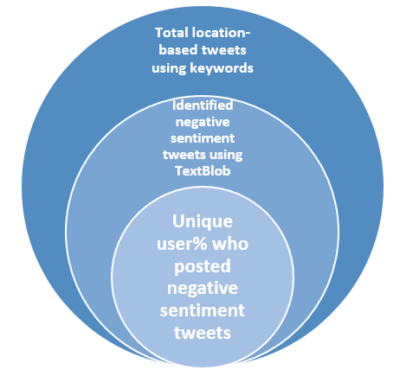
DATA COLLECTION
Twitter data collection and sentiment analysis
Twitter data collection: Keyword-based tweet extraction for the specified city using geographic coordinates for the last 10 years.
The keywords are - crime, theft, violence, gun violence, abscond, harassment, sexual abuse, assault, bribe, burglar, offense, unlawful, forgery, illegal, gambling, violation, homicide, imprisonment, trafficking, extortion, manslaughter, criminal, perjury, robbery, terrorism, terrorist.
Notes:
For Twitter data collection, we used keyword-specific, location-based tweet collection from 2011 to 2021. The above-listed keywords were used. Information like the tweet content, tweeted on Date and User ID was recorded among other variables.
Sentiment analysis: Based on the tweets collected, sentiment analysis using TextBlob was conducted to find truly ill negative sentiment tweets from the entire pool of tweets.
Unique users from the total tweets and the negative sentiment tweets were compared to get the "%unique users who posted negative sentiment tweets" in a given year-month.

Slide 7
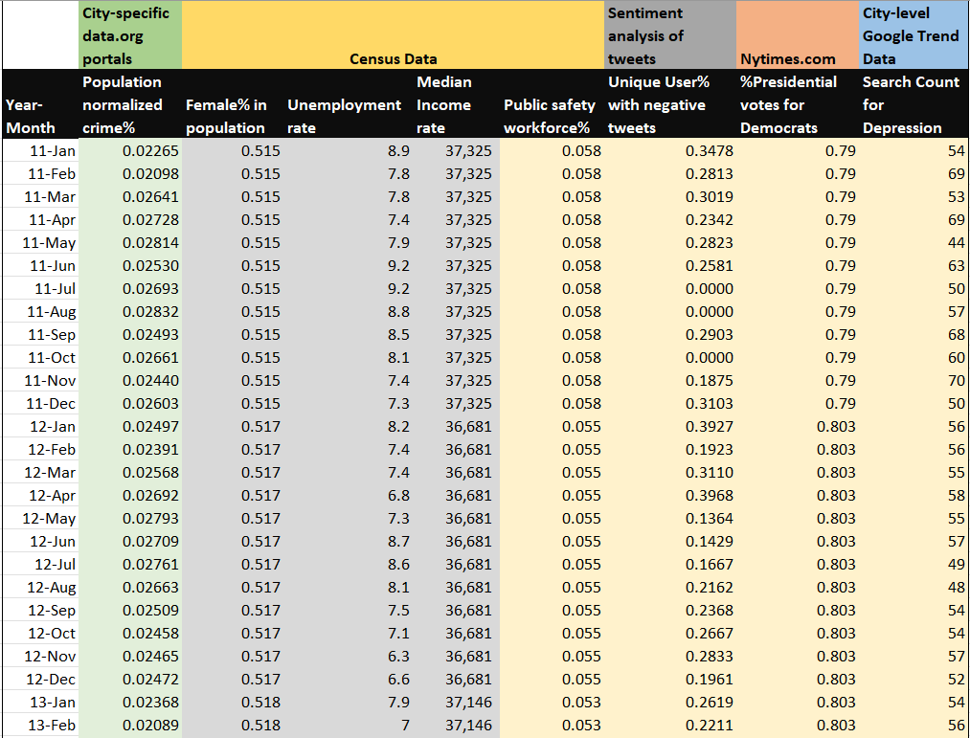
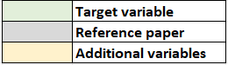
DATASET SNAPSHOT
OF NEW ORLEANS
Notes:
We will use this snapshot to understand our entire data collection process,
The Data is collected from 2011 to 2021 for each Year-Month.
Population normalized crime% is the percentage of crime records(collected from data.org portals) normalized by the population given by census data.
The Gender Ratio, Unemployment Rate, Median Income Rate and Public Safety Workforce% are all collected form the Census Data.
This column is calculated using sentiment analysis on tweets liked we discussed in the last slide.
%Presidential votes for Democrats is the %votes for the Democratic presidential candidate in each of 2008, 2012, 2016 and 2020 election. Data for non-election years is repeated for the last election year.
This column shows the ranking of the word “depression” from city-specific google search trends data. The month-year with the highest searches for depression will have a value of 100. The other Year-month will be relatively ranked to this.
Finally, to summarize,
The column in green is out target variable
The columns in Grey are from the reference paper
The columns in light yellow are the additional variables that we have added.

Slide 8
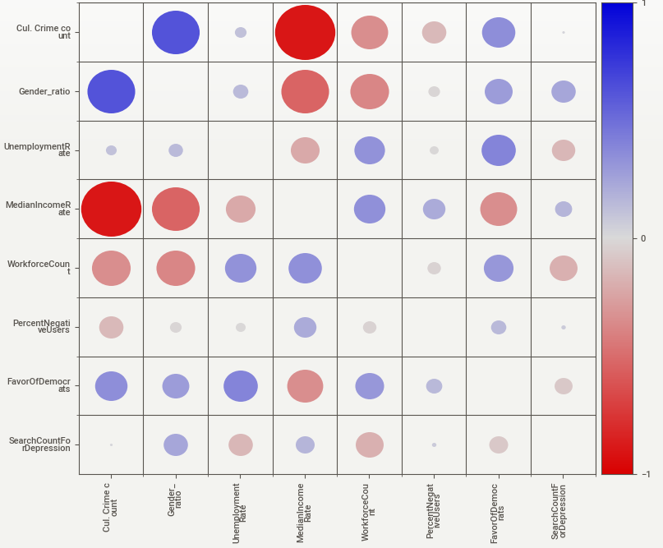
EXPLORATORY DATA ANALYSIS
CITY: NYC
Notes:
This is the correlation matrix of the NYC-dataset, we can see high correlations here but I want this to be further discussed in detailed in the inferences part.

Slide 9


MODELING APPROACH
REFERENCE PAPER
PROPOSED MODEL
Given the prior research[1] done in the field of crime analytics, there is a clear correlation between demographic factors like gender ratio, household income scale, and unemployment rate with criminal activities.
We want to examine whether negative emotions expressed on social media, political affiliations, and %personnel in public safety also have a correlation with criminal activities.
Notes:
So this is our modeling approach, We propose our model with additional variables like negative emotions on Twitter, REPETITIVE?

Slide 10

MODELING TECHNIQUES
SENTIMENT ANALYSIS
REGRESSION MODEL
CHANGEPOINT ANALYSIS
Used TextBlob's sentiment analysis library to pick negative tweets.
One additional nuance was to omit the keywords mentioned in previous slides to make the input tweet neutral.
e.g. a tweet like - "the show criminal minds is crazy" should not be flagged as a negative tweet due to the word "criminal".
Linear Regression using the OLS library from statsmodels.
Used 10-fold cross-validation to account for class imbalance problem.
Model performance is evaluated using the Average MSE and Standard Deviation of the MSE.
The idea of this analysis is to identify the subtle changes in crime cases over time and to correlate that with certain major events like law enforcement, riots, etc.
The PELT approach for changepoint detection was used to detect changes in the mean and variance of crime cases distribution.
Notes:
Let’s talk about the different modeling techniques that we have used:
Sentiment Analysis – Along with TextBlob’s sentiment analysis library, one additional nuance was to neutralize tweets by omitting certain keywords like criminal.
Regression Model – Used linar regression in combination with 10-fold cross validation to account for class imbalance.
Changepoint Analysis - We have also used change point analysis to identify subtle changes in the mean and variance of the overall crime trend since 2011 and tried to collect political events that might have caused the same.
I call Rishabh to now discuss the Inferences we collected using these techniques.

Slide 11
INFERENCES
Notes:
Hi everyone. So, as we got to know till now how our data looks and what all modeling techniques we applied, it is very critical to find out meaningful information derived from the results. Among plenty of inferences, here are some of the interesting facts to know about, when we see the impact of various attributes towards crime rate among cities in US.

Slide 12
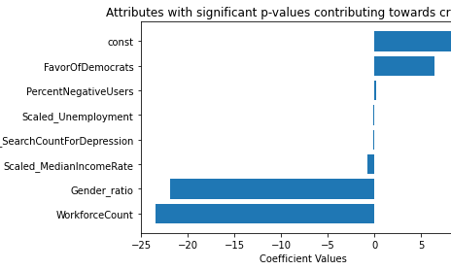
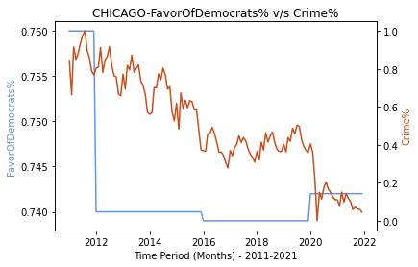
EFFECT OF POLITICAL INCLINATION TOWARDS DEMOCRATS IN CHICAGO
Notes:
It might be shocking to know that crime rate is dependent upon whether the city is ruled by Democrats or Republicans. For instance, percent of population in favor of democrats is positively correlated to the crime rate in Chicago, while the same is negatively correlated in Denver.

Slide 13
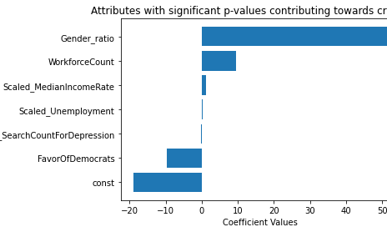
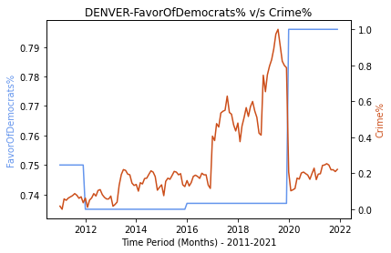
EFFECT OF POLITICAL INCLINATION TOWARDS REPUBLICANS IN DENVER
Notes:
Negative correlation would infact mean crime rate is more when there is more population in favor of Republicans. This is evident from the p-value graph as well the time-series graph depicted here.

Slide 14
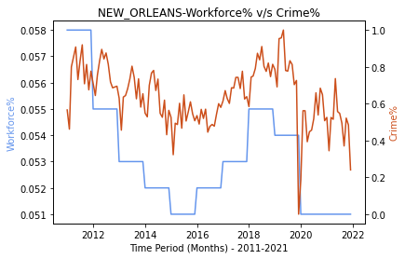
EFFECT OF PUBLIC SAFETY WORKFORCE ON CRIME RATE
IN NEW ORLEANS
Notes:
Now, talking about the percent of population working in the public safety, according to the regression results, we saw that majorly in all cities, increasing the workforce showed a decrease in crime rate, which is ideally an expected scenario. But as we know, ideal is never ideal, there lies anomalies, like the city of New Orleans which follows the exact opposite trend than expected. For this city specifically, which always remains on top of the charts in terms of the greatest number of crimes in US, there are too many other factors leading to such outrageous crime activities there.

Slide 15
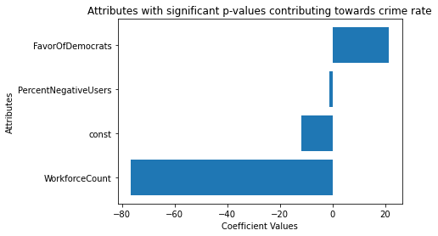
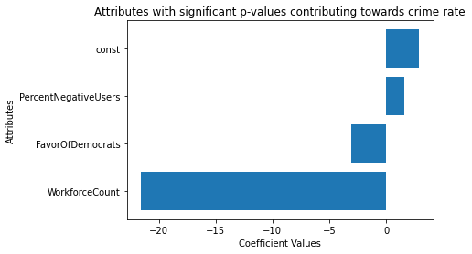
EFFECT OF NEGATIVE TWEET SENTIMENT
NEW YORK
DENVER
Notes:
Now, inferencing for tweets, a hot topic today, thanks to Elon, we wanted to know how does the crime rate affect the number of negative tweets posted by users, and we found that in New York, even with increase in crime rate, lesser population is actually posting tweet with negative sentiments about the same. While it is showing a satisfactory response from users in Denver, with more people expressing on twitter, for increase in crime rate, or vice versa.
Some other important inferences were:
1. Depression is not leading to increase in crime rate, in contrary to what we assumed, as there is no positive correlation found for number of searches made for the word depression v/s the crime rate.
2. Poverty (which is related to MedianIncomeRate) comes out to be positively correlated with crime count in nearly all cities, as expected, because money is the root cause for crime.

Slide 16
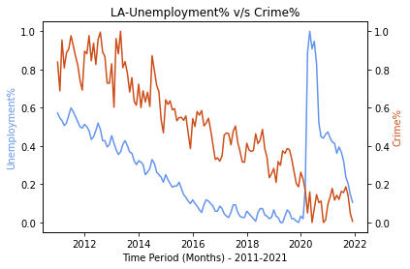
IMPACT OF COVID-19 ON CORRELATION OF UNEMPLOYMENT RATE
AND CRIME RATE IN LOS ANGELES
Notes:
There are also some interesting impacts of Covid-19, affecting behaviour of few attributes towards crime rate. For instance, very large proportion of population lost their jobs due to the pandemic, thus we can see a sudden spike in the unemployment rate from 2019-2021. This is such a huge spike that it started showing negative correlation with the crime rate, intuitively visible in graph.

Slide 17
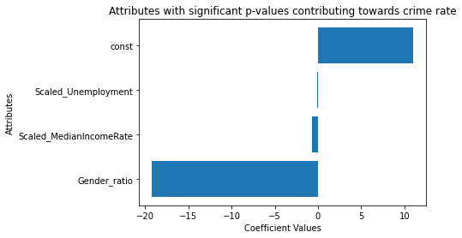
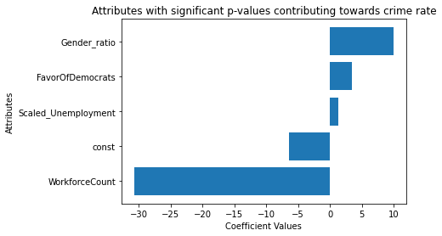
IMPACT OF COVID-19 ON CORRELATION OF GENDER RATIO
AND CRIME RATE IN LOS ANGELES
FROM 2011-2021
FROM 2011-2019
Notes:
Thus, we split our dataset in this way, and infer that our assumption of positive correlation of unemployment does hold right, when the effect of the sudden spike is removed. We also saw that for LA specifically, there were larger ratio of females doing crime, while the behavior significantly switched to larger ratio of males doing crime when covid data was included in our model.

Slide 18
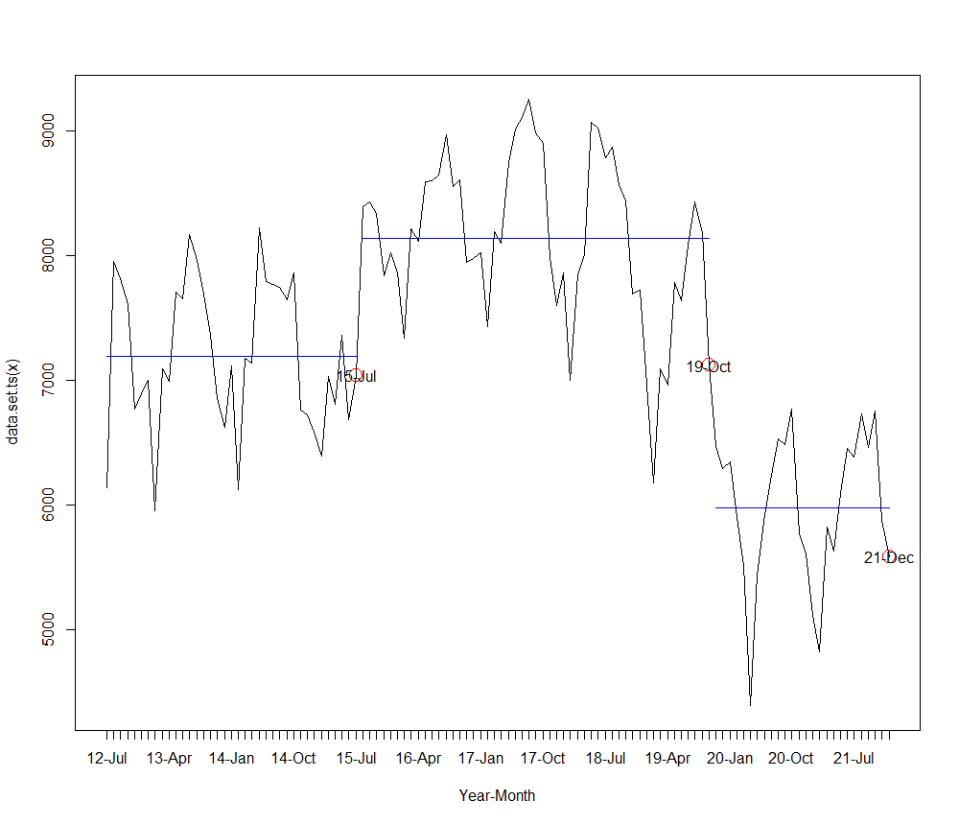
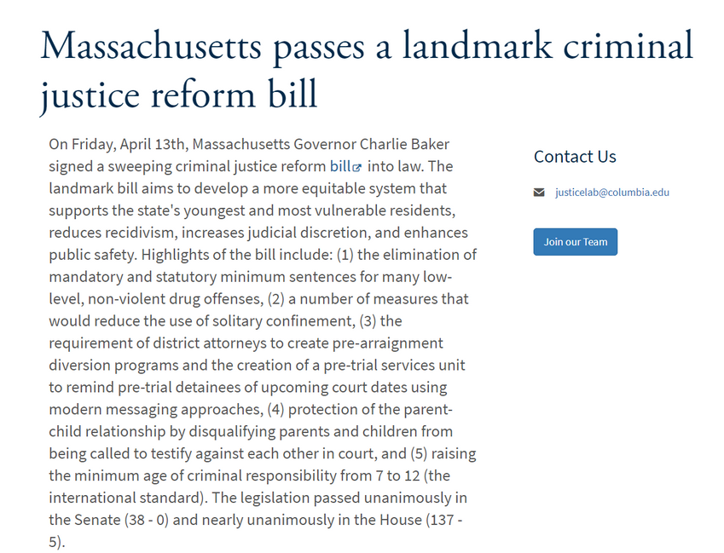
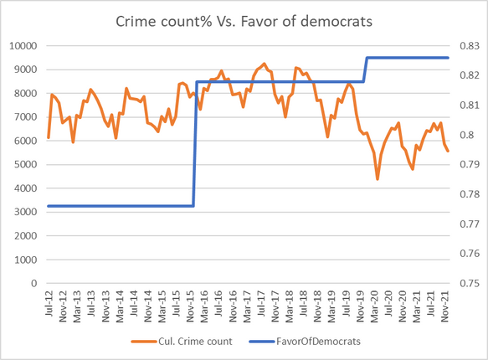
CHANGEPOINT ANALYSIS: BOSTON
Notes:
We also did PELT (Pruned Exact Linear Time) analysis, which provided us with the change points in the time series plot. One among many inferences collected is related to the pass of landmark criminal justice reform bill in Boston in April 2019, which majorly eased out many low-level offences, and increased minimum age of criminal responsibility from 7 to 12, thus showing reduction in crime rate. This is also evident from this graph, which explains that crime rate is actually getting reduced when more population are in favor of democrats, who passed this bill.

Slide 19
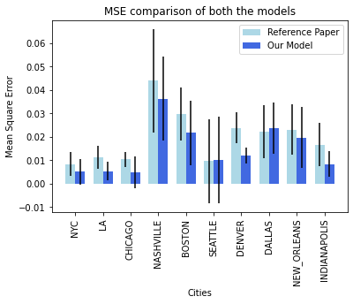
PROPOSED MODEL PERFORMANCE: MEAN SQUARED ERROR
Notes:
Post-training the linear model using 10-fold cross-validation on all 10 cities, the MSE values with the error bars and the standard deviation of error are shown, which clearly validates that our model with additional attributes does tend to do better prediction for crime rate, when compared to the basic attributes concluded by the reference paper, and so is our conclusion.

Slide 20
CONCLUSION
BASED ON THE ABOVE INFERENCES, WE CONCLUDED THAT ADDITIONAL VARIABLES LIKE TWITTER SENTIMENTS, POLITICAL AFFILIATIONS, MENTAL HEALTH, AND PUBLIC SAFETY WORKFORCE DO ADD VALUE WHEN ESTIMATING CRIME.

Slide 21

FUTURE SCOPE
Comparison analysis of multiple cities' correlation coefficients and accuracies.
Demonstrate correlation across different crime categories(arson, theft, etc) to understand which crime categories people generally raise their voices against.
Perform more modeling techniques to fit our dataset.
Notes:
There are plenty of analysis yet possible which we could not perform given the time frame. Some of which are to run comparative analysis across cities, determine granular level of correlation with respect to categories of crime like violent, theft, rape etc, and which are the ones people raising their voice most. We can also perform other modeling techniques to fit in our data.

Slide 22
REFERENCES
[1] Ajimotokin, S., Haskins, A. and Wade, Z., 2015. The effects of unemployment on crime rates in the US.
[2] Towers, S., Chen, S., Malik, A. and Ebert, D., 2018. Factors influencing temporal patterns in crime in a large American city: A predictive analytics perspective
[3] South, S.J. and Messner, S.F., 2000. Crime and demography: Multiple linkages, reciprocal relations. Annual Review of Sociology, pp.83-106.
Notes:
Here are links to the references we used.

Slide 23
THANK YOU
QUESTIONS?
Notes:
Thank you everyone. Also, I would like to Thank Hanjia for his prompt feedbacks. We are open to questions now.

